Slide 1
Applied Probability Club
Stock Options
Trading

Slide 2

VIDEO!!!

Slide 3
What is Options Trading
Call & put options
Call: Right to buy a stock at a set price
Put: Right to sell a stock at a set price
(You have the right but aren’t forced to)

Slide 4
Terms in Options Trading
Strike Price → The price at which you can buy/sell the stock.
Expiration Date → The date the option contract expires (this is where most of the risk is).
Premium → The price you pay for the option contract.
ITM (In The Money) → The option has intrinsic value (profitable if exercised).
OTM (Out of The Money) → The option has no intrinsic value (not profitable yet).
IV (Implied Volatility) → Market expectations of future price swings, affecting the option price.

Slide 5
How to Make Money!
Buying Options (Directional Betting)
How to Make Money!
Selling Options (Being the Casino)
If you think the stock will go up
Buy Calls
(Long the stock)
If you think the stock will go down
Buy Puts
(Short the stock)
Or you could do both:
Straddles
If you think the stock won’t go up (much)
Sell Calls
If you think the stock won’t go down (much)
Sell Puts

Slide 6
WHY?
Leverage → Control 100 shares with less capital.
Hedging → Protect stock holdings from market drops.
Income Generation → Selling options for consistent premiums.
Speculation → Bet on big stock movements with limited risk.
Honestly
Really good question; they’re kinda rigged soooo, yeah
We’ll have a look at the maths later

Slide 7
Dangers
Time Decay (Theta) → Options lose value over time.
Implied Volatility Crush → IV can drop after earnings, hurting the option price.
Expiration Risk → If the stock doesn’t move enough, options expire worthless.
Unlimited Risk (If Selling Naked Options) → A stock can skyrocket or crash, leading to huge losses.

Slide 8
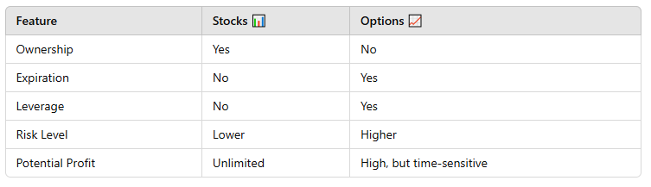
Options vs. Stocks

Slide 9
Probability Distributions in Stock Prices
Stocks move randomly (but not too randomly)
Log-normal distribution
Brownian motion

Slide 10
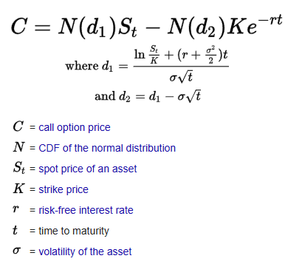
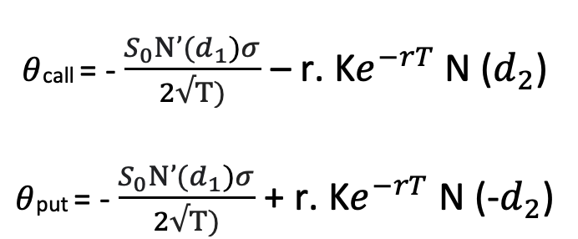
Expected Value & Probability in Options
https://www.youtube.com/watch?v=A5w-dEgIU1M

Slide 11
Monte Carlo Simulations in Options
Simulating stock paths (rolling dice with math)
Estimating fair prices via randomness
A real-world application of gambling but smarter

Slide 12
Conclusion & Q&A
Probability = Edge in trading
Using probability to trade smarter
Any questions?

